Slide 1

Topic D Data Warehouse

Slide 2
Data Warehouse
CONTENT
What is a data warehouse?
Why do we need a data warehouse?
Characteristics of a data warehouse
Dimension Model
Slowly Changing Dimension
Fast Changing Dimension

Slide 3

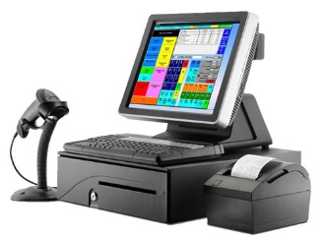




What Is a Data Warehouse (DW)?
Data from social media
Data from Point-Of-Sales systems
Data from Inventory system
A very huge database specially designed to enable Business Intelligence activities
Data stored in the DW is uploaded from internal operational systems such as sales, marketing etc and/or external sources like social media, government data,weather data etc
DW keeps historical data which can be used to create annual / quarterly trends reports for management
Data Warehouse
Data from online-orders
Data from Marketing database
Data from HR database

Slide 4






What is a data warehouse?
A Data Warehouse integrates data from an organisation’s internal operational systems as well as data from external sources such as social media or partner and government
Data from Point-Of-Sales systems
Data Warehouse
Data from online-orders
Data from Marketing database
Data from HR database
Data from social media (unstructured data)
Data from government (data.gov.sg)

Slide 5
Why do we nee a data warehouse? – The Problem
Data from Point-Of-Sales systems
In this information age, many companies use IT systems to store their valuable company data
Many companies do not use one single IT system to keep the data, but often use disparate systems that store data in vastly different ways
E.g. ordering system using Oracle database, marketing database using SQL Server etc
Data from Inventory system
Data from Marketing database

Slide 6

Why do we nee a data warehouse? - Good decisions need data
To stay competitive, companies need to be able to make quick and well-informed decisions
To do so, companies need easy and speedy access to relevant data that are stored in their various operational systems
As such, instead of relying on real data and facts based on historical trends to drive strategic direction, companies end up making decisions based on experience, limited and sometimes outdated information
Companies need to make good decisions to stay competitive

Slide 7
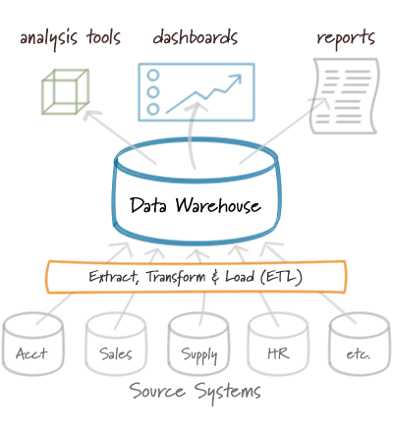
Why do we nee a data warehouse? - The Solution
To solve this problem of ‘unreachable’ fragmented data’, more and more companies have turned to the use of data warehouses
By building a data warehouse, a company can integrate all its most important data residing in different systems to a central location – with a SINGLE VERSION OF TRUTH
After the data warehouse has been built, the company can then use BI tools to access the data to help them make the best strategic decisions

Slide 8
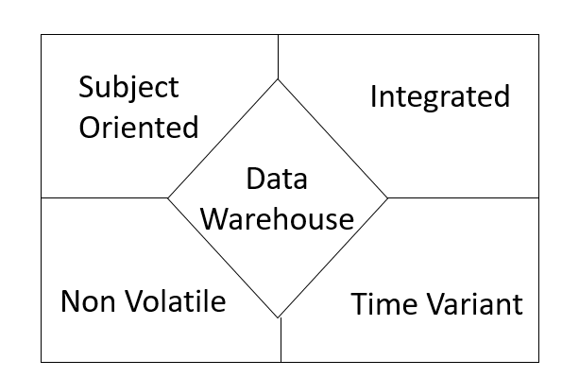
Characteristics of a data warehouse
A data warehouse is a subject-oriented, integrated, time-variant and non-volatile collection of data in support of management's decision making process

Slide 9
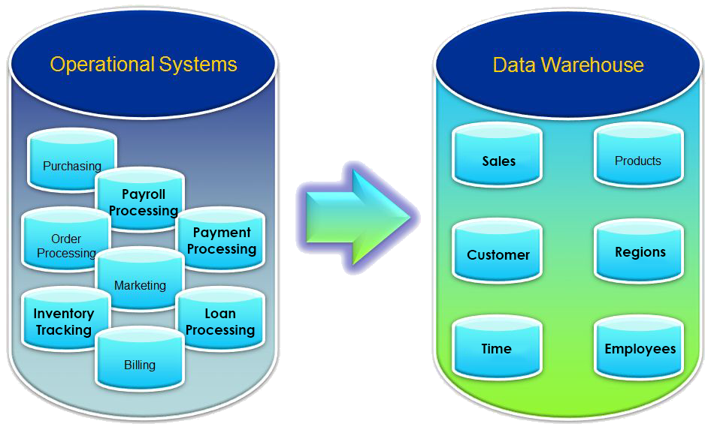
Characteristics of a data warehouse – Subject Oriented
Operational systems organise their data to cater to the process
Data warehouse organize the data based on the subject

Slide 10
Characteristics of a data warehouse – Process vs Subject
Let take an example of a process-oriented situation.
Assume we are talking about people buying properties. The process is simplified as follows:
Process 1 – Buyers, Property Agents, Property Agencies, Developers
Process 2 – Bankers, Banks, Loans,
Process 3 – Lawyers, Law Firms, Banks, Buyers
Process 4 – Buyers, Developers, Building Control Authority, Income Tax Authority
Each process has many applications to support the process. All the data from the processes are collected into a database designed for transactional purposes.
1.Select property
2.Apply loan
3.Sign up loan contract
4.Possess property

Slide 11
Characteristics of a data warehouse – Process vs Subject
In DW, we are concerned with the data surrounding the subjects.
From the previous slide, we have the following subjects
Buyer
Banks, Bankers, Loans
Property Agencies, Property Agents
Developer, Property
Law Firms, Lawyers, Contracts
Building Control Authority
Income Tax Authority
In DW, we need to collect the data pertaining to each of these subjects. The process is not important in DW.

Slide 12
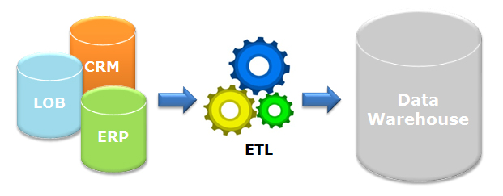
Characteristics of a data warehouse - Integrated
Constructed by integrating data from multiple heterogenous sources: Relational databases, flat files, on-line transactional records.
Data cleansing and data integration techniques are applied before data is stored in the warehouse.
Ensure consistency in naming conventions, encoding among different data sources e.g. always “Singapore” instead of “SG“, “S’pore”

Slide 13
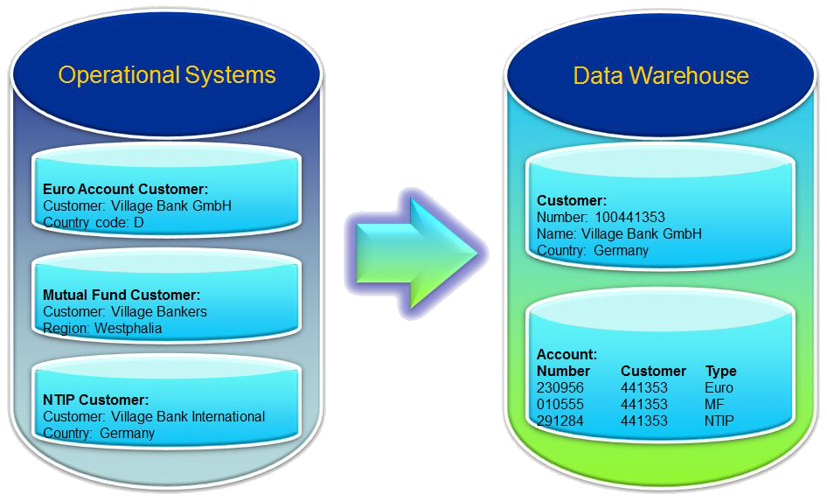
Characteristics of a data warehouse - Integrated
Integration of data within a warehouse is accomplished by making the data consistent in format, naming and other aspects

Slide 14
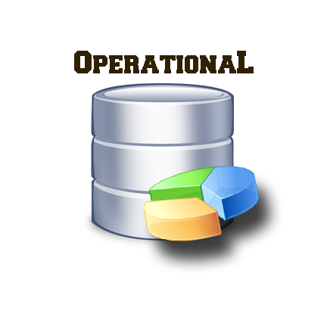

Characteristics of a data warehouse – Time Variant
A data warehouse keeps historical data
For example, one can retrieve data from 3 months, 6 months, 12 months, or even older data from a DW
This contrasts with a transactions system, where often only the most recent data is kept
For example, a transaction system may hold the most recent address of a customer, but a data warehouse can hold all addresses associated with a customer.
Time horizon: 6 months – 1 year
Records are updated
Not compulsory for key structure to contain an element of time
Time horizon: 5-10 years
Sophisticated snapshots of data
Key structure contains an element of time

Slide 15
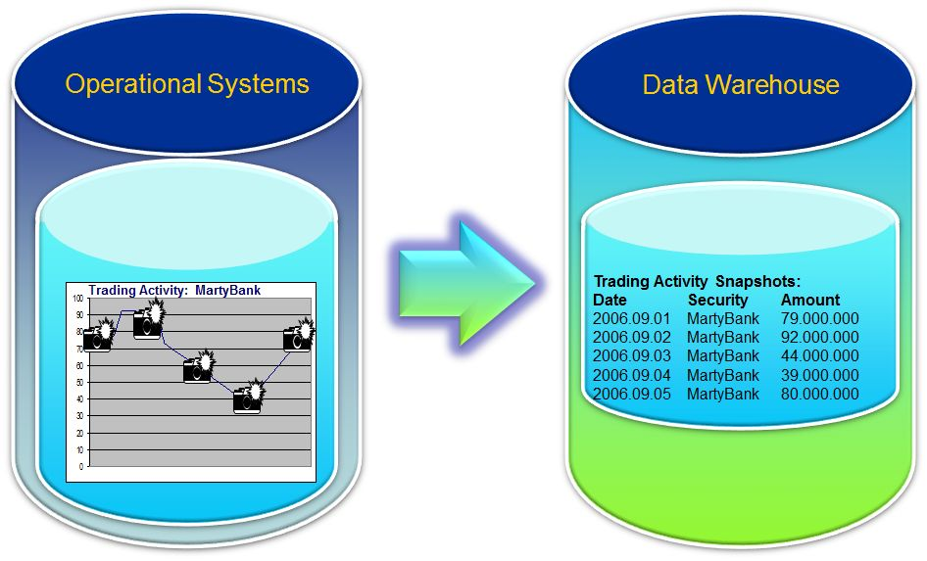
Characteristics of a data warehouse – Time Variant
“Snapshots” of operational data are taken at different times regularly (e.g. once a day) and stored in the DW
Hence, company can retrieve “time-variant” data

Slide 16
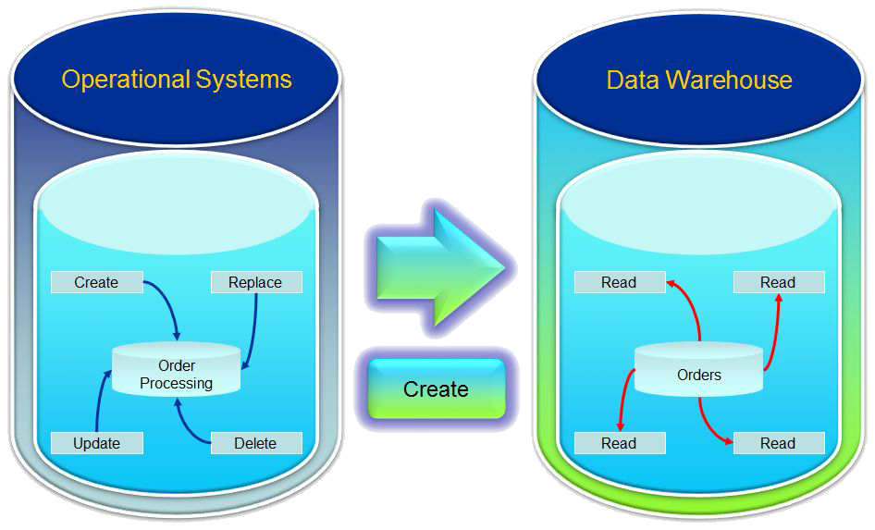
Characteristics of a data warehouse – Non Volatile
Non-volatility means that after the data warehouse is loaded there are no changes, inserts, or deletes performed against the informational database.

Slide 17
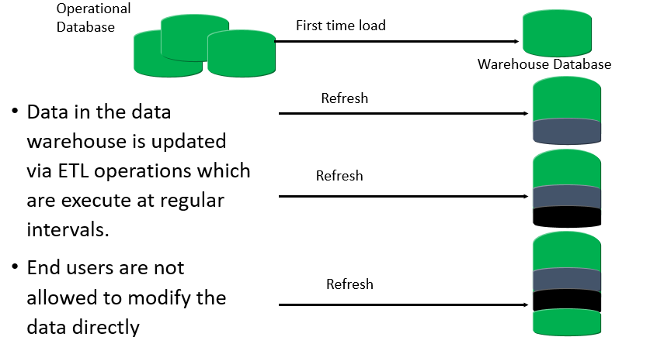
Characteristics of a data warehouse – Non Volatile

Slide 18
Dimensional Model
Dimension modelling is a database design technique that used to support Online Analytical Processing (OLAP) IT systems.
OLAP systems are IT software that companies use to ask questions about the data related to their business.
E.g. Business Intelligence systems that churn out monthly sales reports for the management of a hotel.
Such systems require that the query operations (SELECT) execute at high speed.
Unlike OLTP systems, OLAP systems DO NOT support transactional operations (add/update/delete) as they are non-volatile.
To achieve high speed of query operations, the database of an OLAP system should reduce the need for tables to be joined as that will slow down the speed of access

Slide 19
Dimensional Model
To reduce the need for tables to be joined, records with repetitive data is kept in the same table as this will eliminate the need to use JOINS to retrieve the necessary data
The main feature of the Dimensional modelling technique is that the tables are denormalized
The advantage of this technique is that the IT system is able to perform query operations very fast and the design is more intuitive to the business user
The disadvantage of this technique is that it produces a lot of redundant data

Slide 20
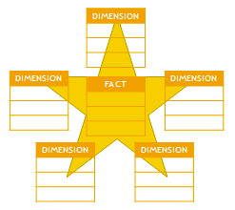
Dimensional Model
Dimensional Modelling is a logical design technique to present data in a framework that is intuitive and allows for high performance access.
It uses relational model but with some modifications.
Every DM consists of a table with a multi-part key called the Fact table and a set of smaller tables called Dimension tables.

Slide 21
Dimensional Model - Components of a Star Schema
Fact A numeric value that measures a data event such as how much was spent on a sales transaction Fact table A central table in a data warehouse that contains several of facts
Dimension A collection of information about a business entity such as a customer / product For example, a customer dimension’s attributes could include first and last name, birth date Dimension table A table in a data warehouse / mart that stores the data of a dimension e.g. Customer dimension table, Product Dimension table

Slide 22
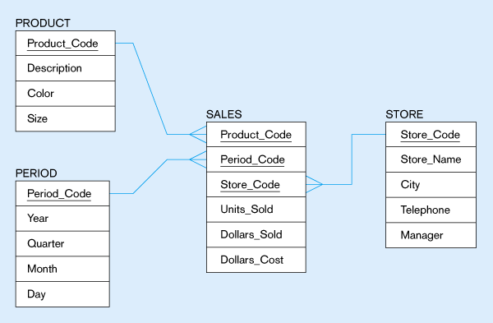
Dimensional Model - Fact
Fact table has the following characteristics:
has a many-to-one relationship to the dimension table
primary key is multi-part
has many more rows than those in the dimension tables
contains primarily numeric data (a.k.a measures) and very few character data

Slide 23
Dimensional Model - Dimensions
Dimension tables has the following characteristics:
has one-to-many relationship to fact table
primary key is single-part
fewer rows than fact tables
contains primarily character data

Slide 24
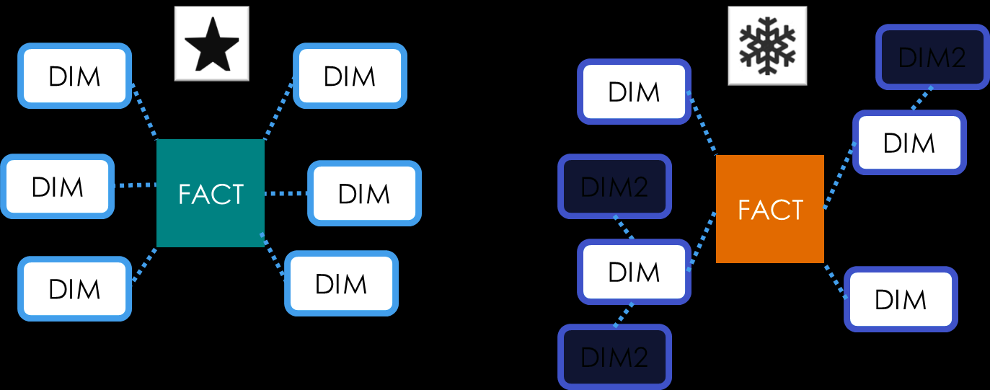
Dimensional Model – Star and Snowflake Schemas
A dimensional model may be based on star schema or a snowflake schema

Slide 25
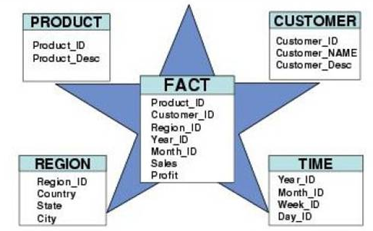
Dimensional Model - Components of a Star Schema
A star schema is characterized as having a fact table in the centre and is surrounded by many dimension tables that contain de-normalized description of the facts
Benefits of a star schema
A star schema is a highly de-normalized set of tables, means
query results come back faster as there would be less JOIN statements in SQL

Slide 26
Dimensional Model - Characteristics of Snowflake Schema
Result of either business environment or third-party application or design which cannot be implemented by a star schema
Dimension tables are of two types: primary and secondary
Primary dimension tables are joined to the fact table
Secondary dimension tables are joined to the primary dimension tables
It can increase query performance if the users are accessing data stored in the primary dimension tables 80% of the time
Snowflake schema may need a number of joins to apply a specific textual constraint to a query

Slide 27
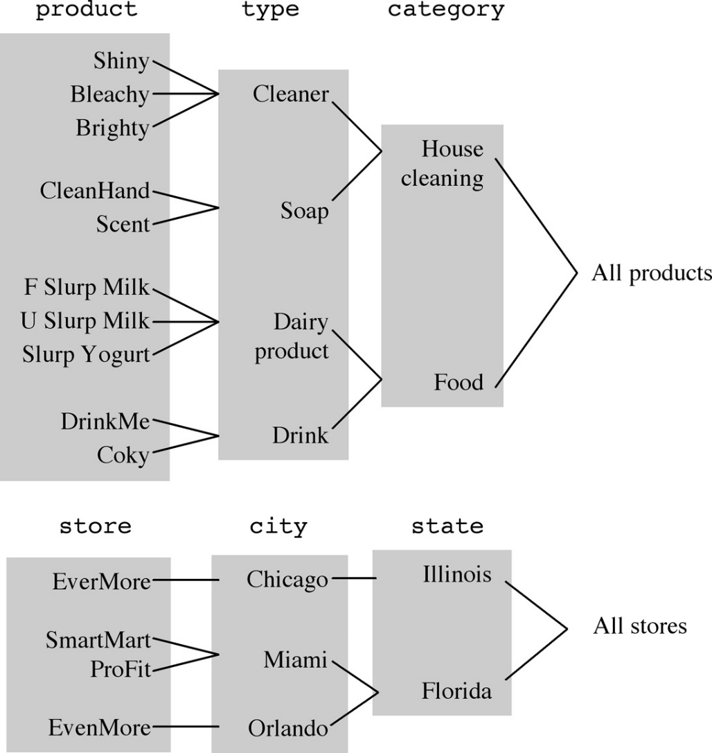
Dimensional Model - Dimension Hierarchies
A useful feature you can build into a Star or Snowflake dimensional model is the “Hierarchy” component
A hierarchy is a logical structure that uses ordered levels to aggregate data (consolidate related data under one group)
E.g. in a Time dimension, a hierarchy can be used to aggregate data from the Month level to the Quarter level, from the Quarter level to the Year level
E.g. In a Product dimension, a hierarchy might be used to aggregate data from the Model level to the Brand level, from the Brand level to the Category level

Slide 28
Dimensional Model - Steps in designing a Star Schema
Identify a business process for analysis (likes sales).
Identify measures or facts (sales dollar).
Identify dimensions for facts (product dimension, location dimension, time dimension, organization dimensions).
List the columns that describe each dimensions (region name, branch name)
Determine the lowest level of summary in a fact.

Slide 29
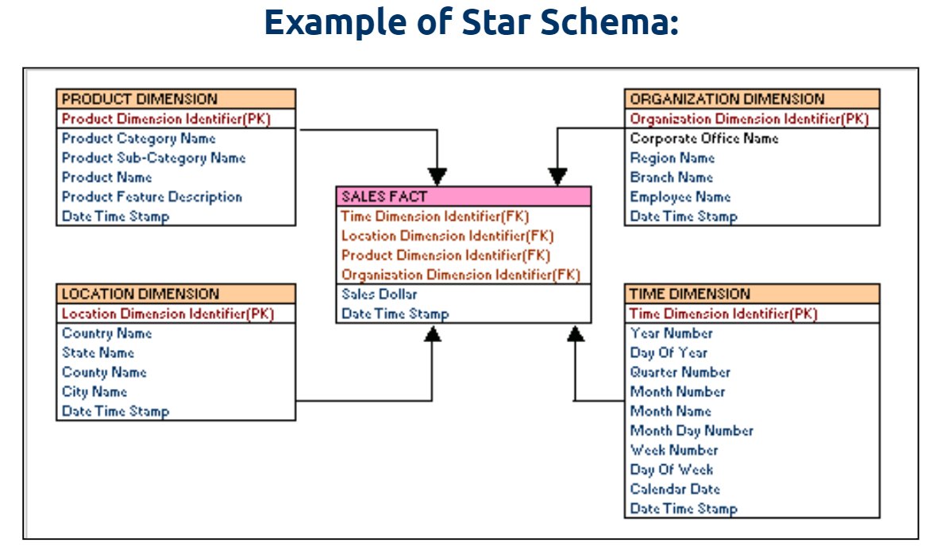
Dimensional Model: Examples
Notes:
In the example, “Sales Dollar” in sales fact table can be calculated across all dimension independently or in a combined manner
Sales dollar value for a particular product be calculated for a product
Sales dollar value for a production in a location
Sales dollar value of a particular year
Discuss on to design a dimension table

Slide 30
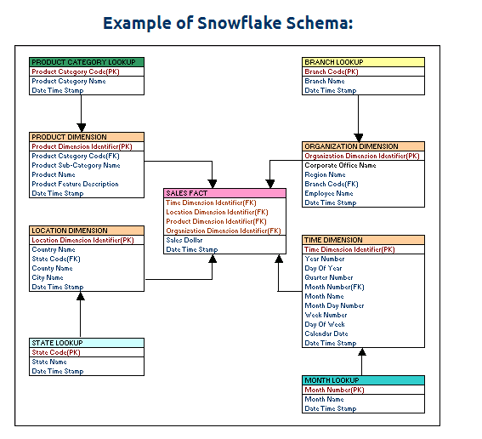
Dimensional Model – Star Schema Example
Notes:
In the example, “Sales Dollar” in sales fact table can be calculated across all dimension independently or in a combined manner
Sales dollar value for a particular product be calculated for a product
Sales dollar value for a production in a location
Sales dollar value of a particular year

Slide 31
Dimensional Model: Star Schema & Snowflake Schema
In a star schema every dimension will have a primary key.
In a star schema, a dimension table will not have any parent table.
Whereas in a snowflake schema, a dimension table will have one or more parent tables.
Hierarchy for dimensions are stored in the dimension table itself in a star schema.
Whereas hierarchies are broken into separate tables in snowflake schema.

Slide 32
Dimensional Model - Surrogate Keys Vs Natural keys
Surrogate keys. A system-generated attribute is added to each entity type table and made the primary key. This attribute is often an artificial number. The primary key for each relationship table consists of identifiers from the related entity types.
Natural keys. A unique combination of application attributes is used to identify each entity. The primary key for each relationship table consists of primary keys from the related entity types.
The natural keys can be used as candidate keys in the Dimensions to facilitate the ETL process.

Slide 33
Dimensional Model - Why use Surrogate Keys
According to Ralph Kimball:
Surrogate keys “ One of the primary benefits of surrogate keys is that they buffer the data warehouse environment for operational changes”
Example, imagine you have used the Product code as key and the operation system re-uses product code. What do you now do with the rest of the old data?
Natural keys (NK) or Business keys are generally alphanumeric values that is not suitable for index as traversing become slower. For example, prod123, prod231 and etc.
Business keys are often reused after sometime. It will cause the problem as in data warehouse we maintain historic data as well as current data.
For example, product codes can be revised and reused after few years. It will become difficult to differentiate current products and historic products. To avoid such a situation, surrogate keys are used.

Slide 34
Dimensional Model – Slowing Changing Dimension
Dimensions that change over time are called slowing changing dimensions.
Most of the fundamental measurements we store in our fact tables are time series, which we carefully annotate with time stamps and foreign keys connecting to calendar date dimensions. But the effects of time are not isolated just to these activity-based time stamps.
All other dimensions that connect to fact tables, including fundamental entities such as Customer, Product, Service, Terms, Location and Employee, are also affected by the passage of time.

Slide 35
Dimension Model – Slowing Changing Dimension
Sometimes the revised description merely corrects an error in the data.
But many times the revised description represents a true change at a point in time of the description of a dimension member, such as Customer or Product.
Because these changes arrive unexpectedly, sporadically and far less frequently than fact table measurements, we call this topic slowly changing dimensions (SCDs).

Slide 36
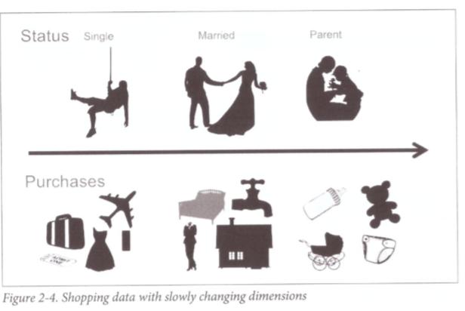
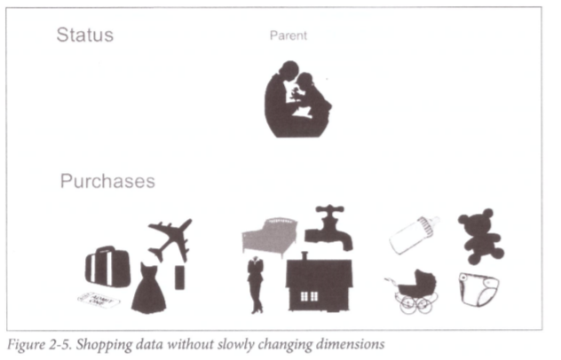
Dimension Model – Slowing Changing Dimension
Source: Alex Gorelik, The Enterprise Data Lake, O’Reilly, 2019
Notes:
Teaching Tips: The goal of a slowly changing dimension is to keep track of a dimension entity’s (eg person) state over time, so that the transaction (or facts) corresponding to the entity’s state reflect that state over time, thus making analysis more accurate in the long run.

Slide 37
Dimension Model – Slowly Changing Dimension
Type 0 - The passive method
Type 1 - Overwriting the old value
Type 2 - Creating a new additional record
Type 3 - Adding a new column
Type 4 - Using historical table
Type 5 - Combine approaches of types 1,2,3

Slide 38
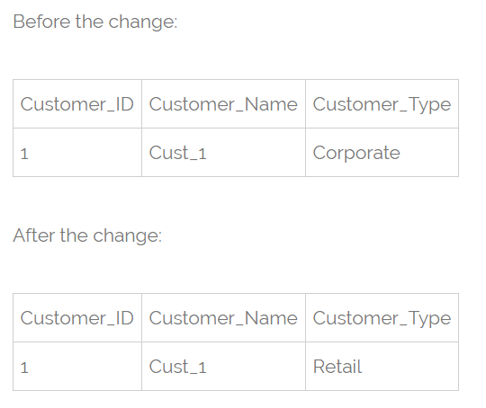
Dimension Model – Slowly Changing Dimension
Type 0 - The passive method. In this method no special action is performed upon dimensional changes. Some dimension data can remain the same as it was first time inserted, others may be overwritten.
Type 1 - Overwriting the old value. In this method no history of dimension changes is kept in the database. The old dimension value is simply overwritten be the new one. This type is easy to maintain and is often use for data which changes are caused by processing corrections(e.g. removal special characters, correcting spelling errors).

Slide 39
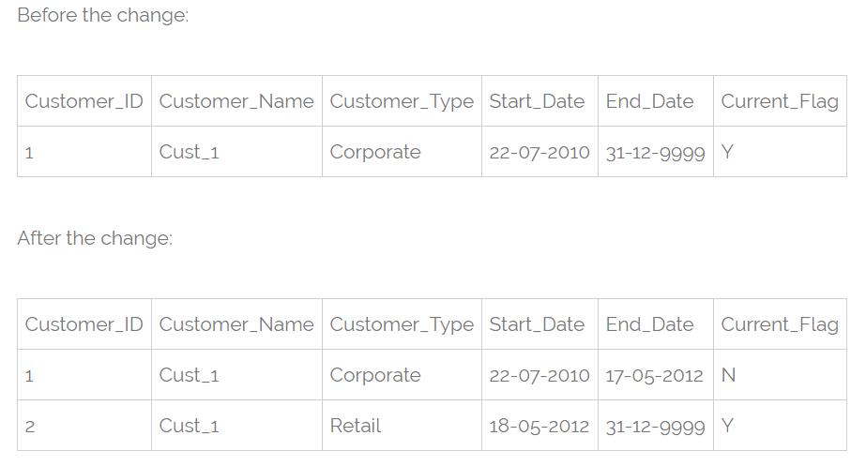
Dimension Model – Slowly Changing Dimension
Type 2 - Creating a new additional record.
In this methodology all history of dimension changes is kept in the database. You capture attribute change by adding a new row with a new surrogate key to the dimension table.
Both the prior and new rows contain as attributes the natural key(or other durable identifier). Also 'effective date' and 'current indicator' columns are used in this method. There could be only one record with current indicator set to 'Y'. For 'effective date' columns, i.e. start_date and end_date, the end_date for current record usually is set to value 9999-12-31.

Slide 40
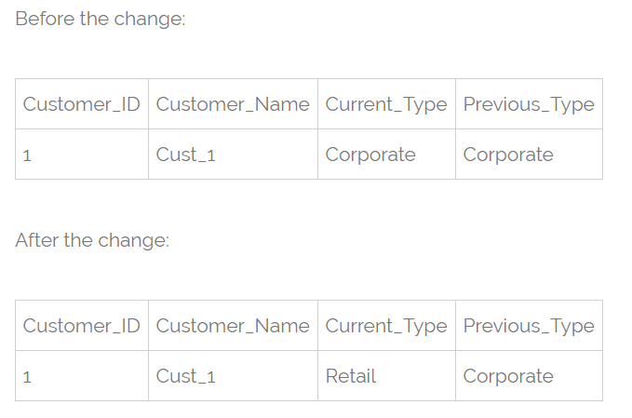
Dimensional Model – Slowly Changing Dimension
Type 3 - Adding a new column.
In this type usually only the current and previous value of dimension is kept in the database. The new value is loaded into 'current/new' column and the old one into 'old/previous' column.
Generally the history is limited to the number of column created for storing historical data. This is the least commonly needed technique.

Slide 41
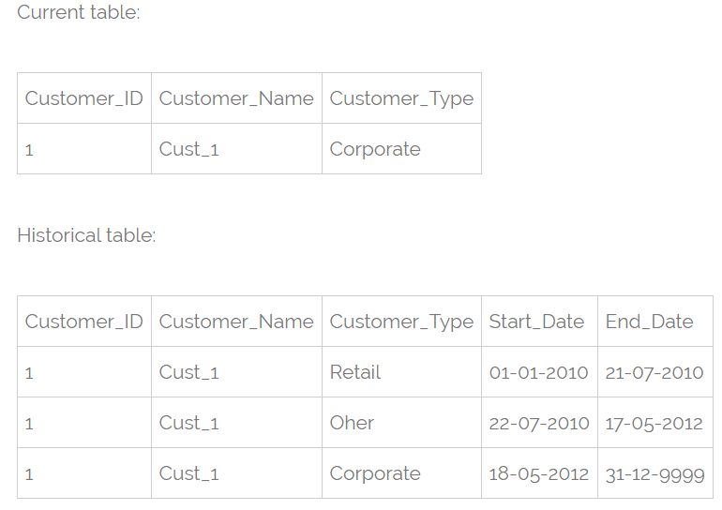
Dimensional Model – Slowly Changing Dimension
Type 4 - Using historical table.
In this method a separate historical table is used to track all dimension's attribute historical changes for each of the dimension.
The 'main' dimension table keeps only the current data e.g. customer and customer_history tables.

Slide 42
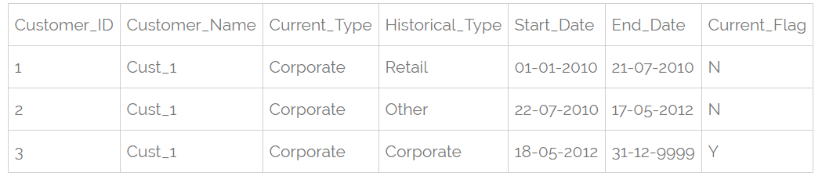
Dimensional Model – Slowly Changing Dimension
Type 5 - Combine approaches of types 1,2,3.
In this type we have in dimension table such additional columns as:
current_type - for keeping current value of the attribute. All history records for given item of attribute have the same current value.
historical_type - for keeping historical value of the attribute. All history records for given item of attribute could have different values.
start_date - for keeping start date of 'effective date' of attribute's history.
end_date - for keeping end date of 'effective date' of attribute's history.
current_flag - for keeping information about the most recent record.
In this method to capture attribute change we add a new record as in type 2. The current_type information is overwritten with the new one as in type 1. We store the history in a historical_column as in type 3.

Slide 43
Dimension Model – Fast Changing Dimension
A dimension is a fast changing or rapidly changing dimension if one or more of its attributes in the table changes very fast and in many rows.
As you know slowly changing dimension type 2 is used to preserve the history for the changes. But the problem with type 2 is, with every change in the dimension attribute, it adds new row to the table.
If in case there are dimensions that are changing a lot, table become larger and may cause serious performance issues. Hence, use of the type 2 may not be the wise decision to implement the rapidly changing dimensions.

Slide 44
Dimension Model – Fast Changing Dimension
Separate Rapidly Changing Attribute by Implementing Junk Dimension
There may be some attribute that may be changing rapidly and other not. The idea here is to separate the rapidly changing attribute from the slowly changing ones and move those attribute to another table called junk dimension and maintain the slowly changing attribute in same table. In this way, we can handle situation of increasing table size.

Slide 45
Dimension Model – Fast Changing Dimension
PATIENT
Patient_id
Name
Gender
Marital_status
Weight
BMI
The attribute like patient_id, Name, Gender, Marital_status will not change or changes very rarely. And attribute like weight and BMI (body mass index) changes every month based on the patient visit to hospital.
So, we need to separate the weight column out of the patient table otherwise we end up filling the table if we use SCD type 2 on PATIENT dimension. We can put the weight column which is rapidly changing into junk dimension table.
Pat_SK is the surrogate key and acts as a primary key for junk dimension table. Below is how our PATIENT table looks after removing weight and BMI from it.
PATIENT
Patient_id
Name
Gender
Marital_status
PATIENT_JNK_DIM
Pat_SK
Weight
BMI

Slide 46
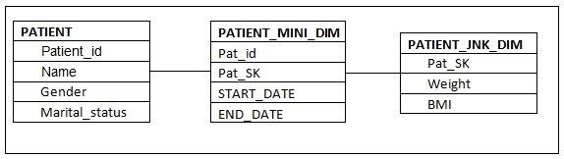
Dimension Model – Fast Changing Dimension
Link Junk Dimension and PATIENT Table
In this step, we must link the junk dimension and patient table. Keep in mind; we cannot simply refer the junk dimension table by adding its primary key to patient table as foreign key. Because any changes made to junk dimension will have to reflect in the patient table, this obviously increases the data in patient dimension.
Instead, we create one more table called mini dimension that acts as a bridge between Patient and Junk dimension. We can also add the columns such as start and end date to track the change history.
PATIENT_MINI_DIM
Pat_id
Pat_SK
START_DATE
END_DATE
This table is just bridge between two tables and does not require any surrogate key in it.
Below is the diagrammatic representation of the Rapidly Changing Dimension implementation

Slide 47
Optional Discussion

Slide 48

Data Warehousing
The process of constructing and using a data warehouse is known as “Data Warehousing”
More and more companies are setting up data warehouses due to the following phenomenon:
the huge increase of data stored in recent years, often spread over different systems
increasing global competition causing the need to make speedy yet informed decisions
Help! Drowning in the huge volume of data…

Slide 49
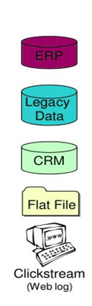
Data Warehousing – Operational Sources
Different data sources that feed data into data warehouse.
Formats like plain text file, relational database, Excel file
Many different types of data can be a data source:
Operations -- such as sales data, HR data, product data, inventory data, marketing data, systems data
Web server logs with user browsing data
Third-party data, such as census data, demographics data, or survey data
Real-time data, such as Internet of Things (IoT) devices
Operational data sources are typically current and volatile

Slide 50
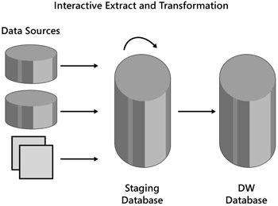
Data Warehousing – Staging Area
A temporary location where data from source systems resides
May exist for timing reasons; due to varying business cycles, data processing cycles, hardware and network resource limitations and geographical factors, cannot extract data at same time
E.g. “Customer" data from a database in Singapore is extracted at a different time from a database in USA

Slide 51
Dimensional Model – Factless Fact Table
A factless fact table is fact table that does not contain fact. They contain only dimensional keys and it captures events that happen only at information level but not included in the calculations level. Just an information about an event that happen over a period.

Slide 52
Dimensional Model – Factless Fact Table
A factless fact table captures the many-to-many relationships between dimensions, but contains no numeric or textual facts. They are often used to record events or coverage information.
Common examples of factless fact tables include:
Identifying product promotion events (to determine promoted products that didn’t sell)
Tracking student attendance or registration events
Tracking insurance-related accident events
Identifying building, facility, and equipment schedules for a hospital or university

Slide 53
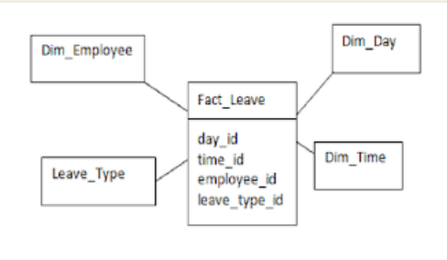
Dimensional Model – Factless Fact Table
Factless fact tables for Events The first type of factless fact table is a table that records an event. Many event-tracking tables in dimensional data warehouses turn out to be factless. Sometimes there seem to be no facts associated with an important business process. Events or activities occur that you wish to track, but you find no measurements. In situations like this, build a standard transaction-grained fact table that contains no facts.
The above fact is used to capture the leave taken by an employee. Whenever an employee takes leave a record is created with the dimensions. Using the fact FACT_LEAVE we can answer many questions like
Number of leaves taken by an employee
The type of leave an employee takes
Details of the employee who took leave

Slide 54
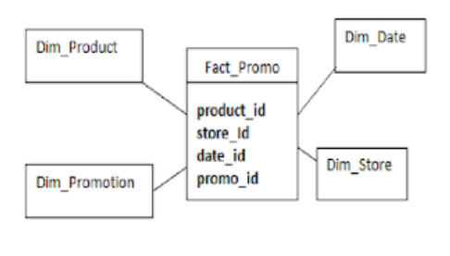
Dimensional Model – Factless Fact Table
Factless fact tables for Conditions Factless fact tables are also used to model conditions or other important relationships among dimensions. In these cases, there are no clear transactions or events. It is used to support negative analysis report. For example a Store that did not sell a product for a given period. To produce such report, you need to have a fact table to capture all the possible combinations. You can then figure out what is missing.
fact_promo gives the information about the
products which have promotions but still did not sell
This fact answers the below questions:
To find out products that have promotions.
To find out products that have promotion that sell.
The list of products that have promotion but did not sell.
This kind of factless fact table is used to track
conditions, coverage or eligibility.

